Slide 1

AI-Driven Prediction of Mental Health Conditions Through Social Media Analysis
(INTRODUCTION TO AI (AI-201B))
Even Semester
Session 2024-25
Tushar Kumar-202410116100227
Vanshika Srivastava-202410116100236
Vanshika Tyagi-202410116100237
Vikas Singh -202410116100244
Project Supervisor:
Mrs. Komal Salgotra
Assistant professor

Slide 2


AI-Driven Prediction of Mental Health Conditions Through Social Media Analysis
Mental health challenges rise globally; AI offers new detection pathways.
Notes:
null

Slide 3
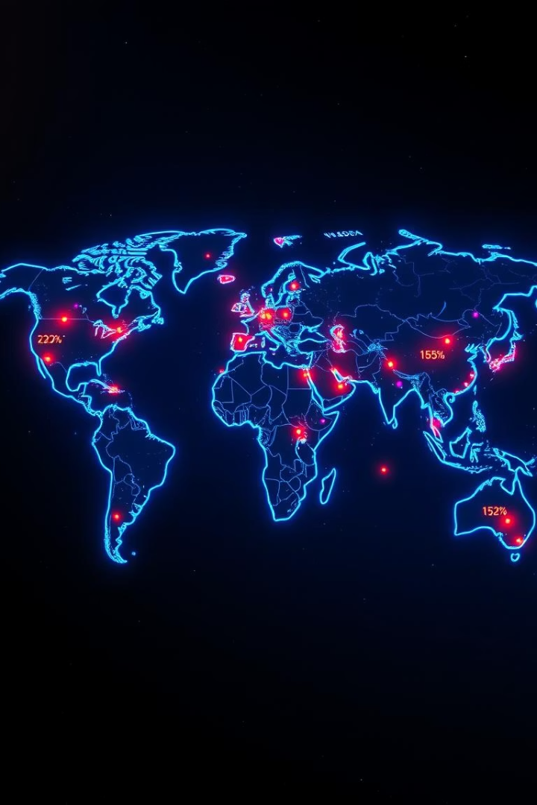
Background and Significance
Global Concern
Mental health leading illness per WHO
Barriers to Care
Stigma, lack of awareness, poor access
Social Media Value
Rich emotional and linguistic cues
Early Detection
Improves outcomes, prevents escalation
Notes:
null

Slide 4


Motivation for the Study
User Expression
Online emotions often unshared elsewhere
NLP & ML
Detect language patterns, sentiment, emotions
Goal
Early, efficient mental health risk detection
Target Groups
Support high-risk populations monitoring
Notes:
null

Slide 5
Problem Context & Challenges
Language Complexity
Platform Variability
Data Labeling Issues
Ethical Concerns
Reddit: long posts
Self-reports or inference bias
Consent, privacy, misclassification
Slang, sarcasm, emojis
Twitter: short posts
Abbreviations, informal text
Notes:
null

Slide 6




Project Scope & Objectives
Classification
1
Features
Depressed, anxious, neutral posts
2
Linguistic, emotional, behavioral
4
Focus
Models
3
Accuracy, interpretability, ethics
SVM, Random Forest, LSTM, BERT
Notes:
null

Slide 7





Data Collection & Preprocessing
Data Collection
Cleaning
Preprocessing
Feature Extraction
Public social media datasets
Anonymization and noise removal
Tokenization, stop word removal, lemmatization
Sentiment, n-grams, emotion analysis
Notes:
null

Slide 8
Machine Learning Models
Classical Models
Deep Learning
Support Vector Machines (SVM)
LSTM (Long Short-Term Memory)
Random Forest
BERT (Transformer-based)
Notes:
null

Slide 9

Ethical Considerations
Data Privacy
Anonymization, user consent compliance
Limitations
False positives, misuse, profiling risks
Transparency
Explainability, responsible use promotion
Notes:
null

Slide 10
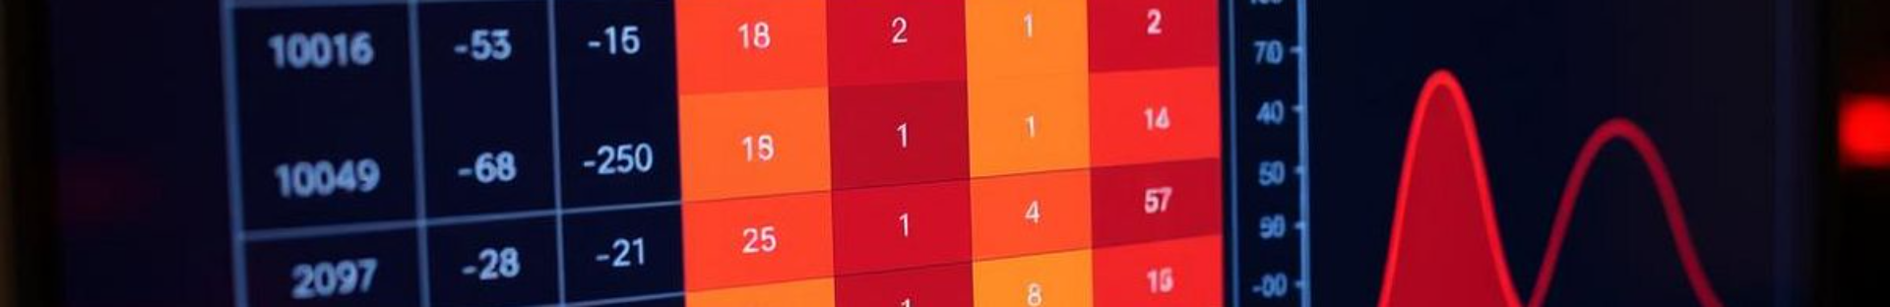
Results and Evaluation
95%
0.92
Top Accuracy
F1 Score
Best model achieved 95% accuracy
High balance between precision and recall
0.93
0.90
Precision
Recall
Minimal false alarms
Strong detection rate
Notes:
null

